Slide 1

Sequential and Random
Subject:- DBMS
Present By: Uzma Banu

Slide 2
Introduction to sequential file organization
In a database management system (DBMS), sequential file organization is a popular method of file organization. It’s a straightforward approach to file organization. This method organizes the data elements into a sequence that is arranged in a binary format, one after the other.
Methods of Sequential File Organization:-
1. Pile File Method
2. Sorted File Method

Slide 3
Pile File Method
In a pile file organization, records are stored in no particular order. New records are simply added to the end of the file, and there is no inherent order or sorting applied to the records.
Advantages:
Simple and easy to implement.
Fast insertion of new records.
Disadvantages:
Searching for specific records can be slow, as there is no predefined order.
Not well-suited for applications that require frequent data retrieval based on a specific criterion.

Slide 4
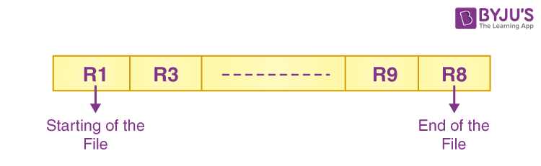
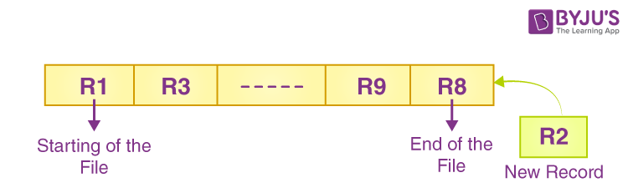
Fig:- Pile File Method

Slide 5
Sorted File Method
In a sorted file organization, records are stored in a specific order based on a key field. The key field is chosen in such a way that it represents the order in which the records are stored. This organization facilitates faster searching and retrieval of records based on the key field.
Advantages:
Quick and efficient searching.
Well-suited for applications where data retrieval is a common operation.
Disadvantages:
Insertion and deletion of records can be time-consuming, as maintaining the sorted order may require shifting records.

Slide 6

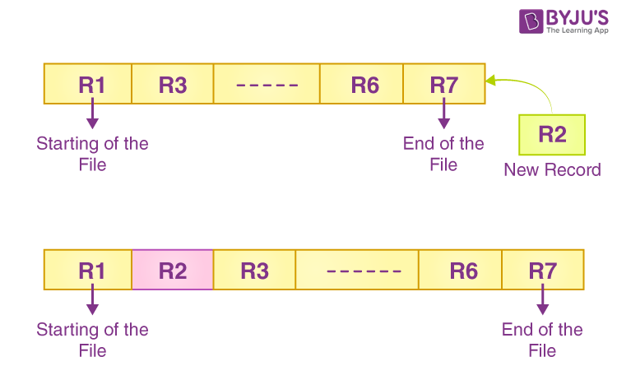
Fig:- Sorted File Method

Slide 7
Random Access File
A random access file is a type of file structure that allows direct access to any record within the file, enabling efficient searching, updating, and retrieval of individual records. Unlike sequential access files where data is organized and accessed sequentially, random access files provide the ability to access records in any order based on their position or key.

Slide 8
Difference between Sequential and Random Access File
Feature | Sequential Access File | Random Access File
Order of Access | Data is accessed in a sequential manner. | Data can be accessed directly without going through other records.
Access Speed | Slower access speed, especially for large datasets. | Faster access speed, as data can be accessed directly.
Insertion/Deletion of Records | Insertion and deletion are less efficient, as it may require rearranging the entire file. | Efficient for insertion and deletion, as records can be added or removed without affecting the others.
Search Efficiency | Less efficient for searching, as it requires scanning through records sequentially. | Efficient for searching, as specific records can be directly accessed using a key or address.
Storage Efficiency | More storage-efficient, as there is no need for additional structures like indexes. | May require additional structures like indexes for efficient random access, leading to increased storage requirements.
Examples | Traditional flat files, tape-based storage. | Directories, hash files, indexed files.

Slide 9
Thanks…!

